Slide 1

Software Engineering
System Modeling
Assoc prof. dr. Tomas Blažauskas, 2018

Slide 2


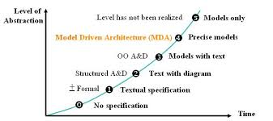

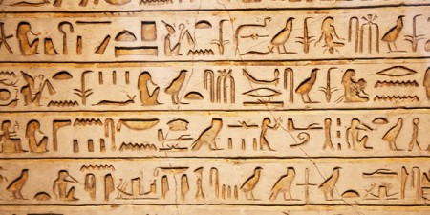
System Modeling...
A way to communicate knowledge required for software creation

Slide 3
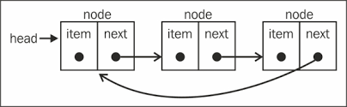

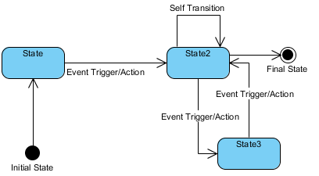
Use of graphical models (why?)
People need a metaphor to understand the complex software.
...I don't even see the code. All I see is blonde, brunette, redhead... (Cypher)

Slide 4
Use of graphical models
As a means of facilitating discussion about an existing or proposed system
Incomplete and incorrect models are OK as their role is to support discussion.
As a way of documenting an existing system
Models should be an accurate representation of the system but need not be complete.
As a detailed system description that can be used to generate a system implementation
Models have to be both correct and complete.

Slide 5

Lecture topics
Context models
Interaction models
Structural/Static models
Behavioral/Dynamic models
Quick view at UML
C4 model
Model-driven engineering
C4

Slide 6
System modeling
System modeling is the process of developing abstract models of a system, with each model presenting a different view or perspective of that system.
System modeling has now come to mean representing a system using some kind of graphical notation, which is now mostly based on notations in the Unified Modeling Language (UML).
System modelling helps to understand various aspects of the system and models are used to communicate with colleagues and customers.

Slide 7

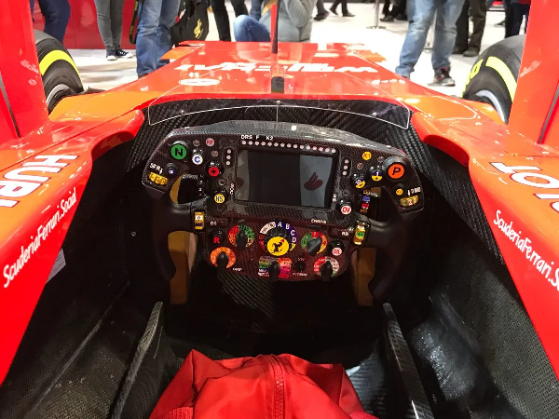
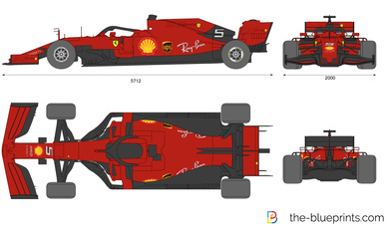
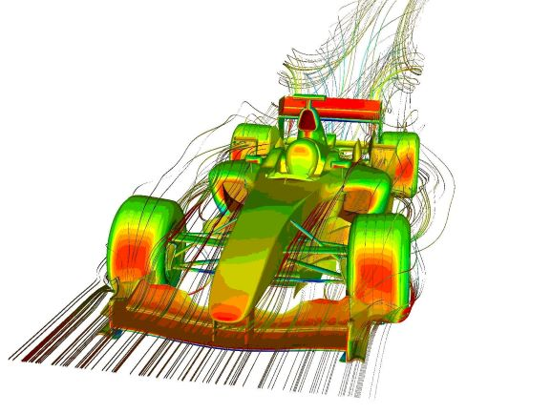
System perspectives/viewpoints
An external perspective, where you model the context or environment of the system.
An interaction perspective, where you model the interactions between a system and its environment, or between the components of a system.
A structural perspective, where you model the organization of a system or the structure of the data that is processed by the system.
A behavioral perspective, where you model the dynamic behavior of the system and how it responds to events.
External perspective
Interaction perspective
Structural perspective
Behavioral perspective

Slide 8
Views
Each perspective can be described using several Views. Views are the instances of the perspectives.
For example, interaction perspective can be described using Use Case, Sequence and Activity diagrams.
There is no exact science (this is an art after all!) how to map views into perspectives.
Any way which allows to describe the system effectively is a good one.
Views

Slide 9
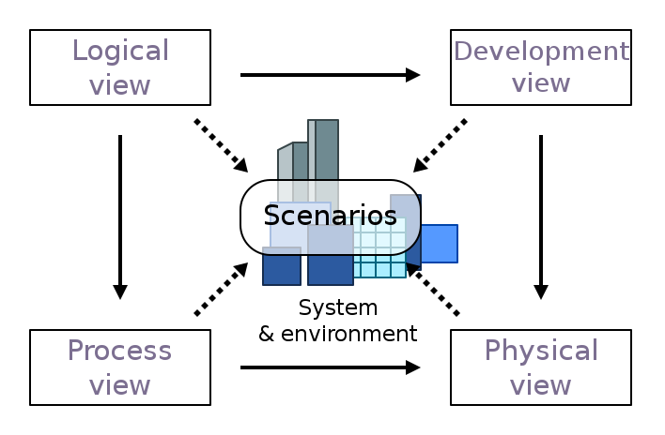
An example: 4+1 Architectural view model
Notes:
The 4+1 Architectural view model was created by Philippe Kruchten and published, back in 1995, in his paper titled “Architectural Blueprints—The “4+1” View Model of Software Architecture“.

Slide 10
An example: 4+1 Architectural view model
Development view: illustrates a system from a programmer's perspective and is concerned with software management. It uses the UML Component diagram as well as Package diagram to describe system components.
Logical view: concerned with the functionality that the system provides to end-users. It includes class diagrams, composite structure diagrams.
Physical view: depicts the system from a system engineer's point of view. Deployment diagram usually is used to represent the physical view.
Process view: deals with the dynamic aspects of the system, explains the system processes and how they communicate, and focuses on the runtime behavior of the system. It includes the activity diagram.
Scenarios: a small set of use cases, or scenarios, which become a fifth view. The scenarios describe sequences of interactions between objects and between processes. In UML we use use case view.

Slide 11
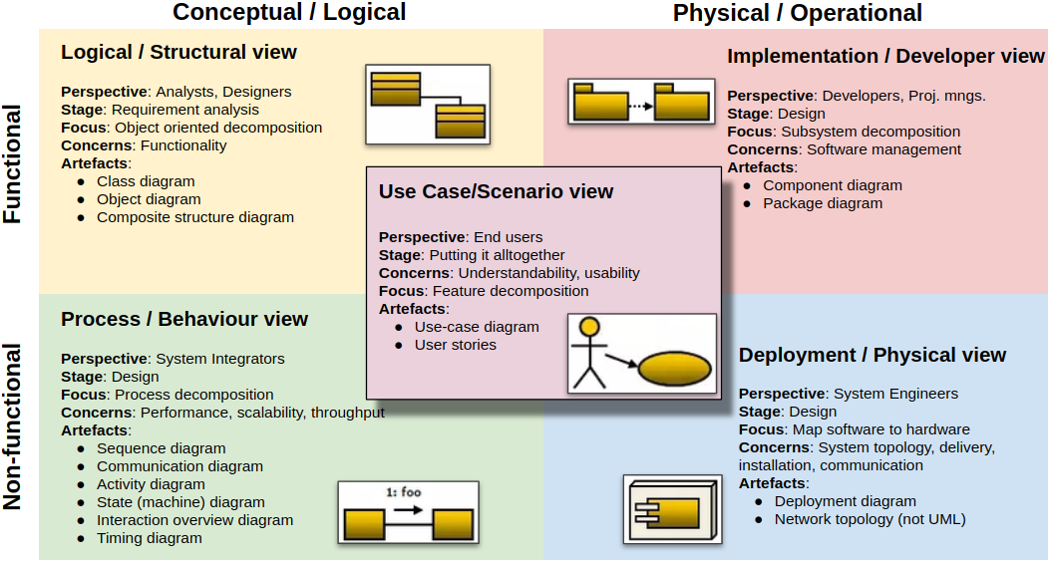
UML and 4+1 model
https://herbertograca.com/2019/08/12/documenting-software-architecture/

Slide 12
Context/Contextual models
Notes:
https://www.youtube.com/watch?v=laSrDtYtkXU&list=PLCku-ULHIQvlLC2gFqeoX-JtbEvmeoDhl&index=1

Slide 13
Context models
Context models are used to illustrate the operational context of a system - they show what lies outside the system boundaries.
Social and organisational concerns may affect the decision on where to position system boundaries.
Architectural models show the system and its relationship with other systems.

Slide 14
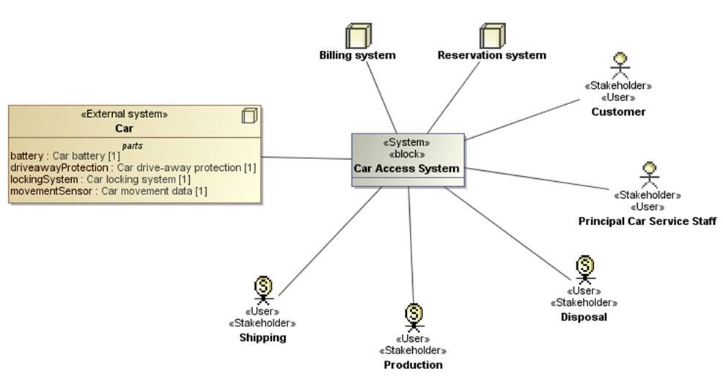
Example: The context of Car access system

Slide 15
System boundaries
System boundaries are established to define what is inside and what is outside the system.
They show other systems that are used or depend on the system being developed.
The position of the system boundary has a profound effect on the system requirements.
Defining a system boundary is a political judgment
There may be pressures to develop system boundaries that increase / decrease the influence or workload of different parts of an organization.

Slide 16
UML and context models
There is no single diagram in UML that could be used to define a context of the system, but there are several diagrams that can show the frontier between the system and its surrounding world from different perspectives.
The UML boundary element is used to provide a context in different diagrams.
Use case, deployment, component diagrams could be used to show the context.

Slide 17
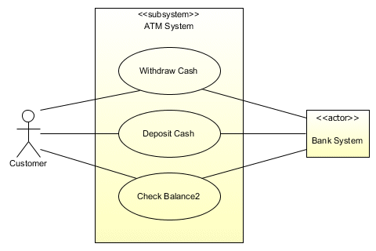
Example of use-case diagram: ATM system boundary

Slide 18
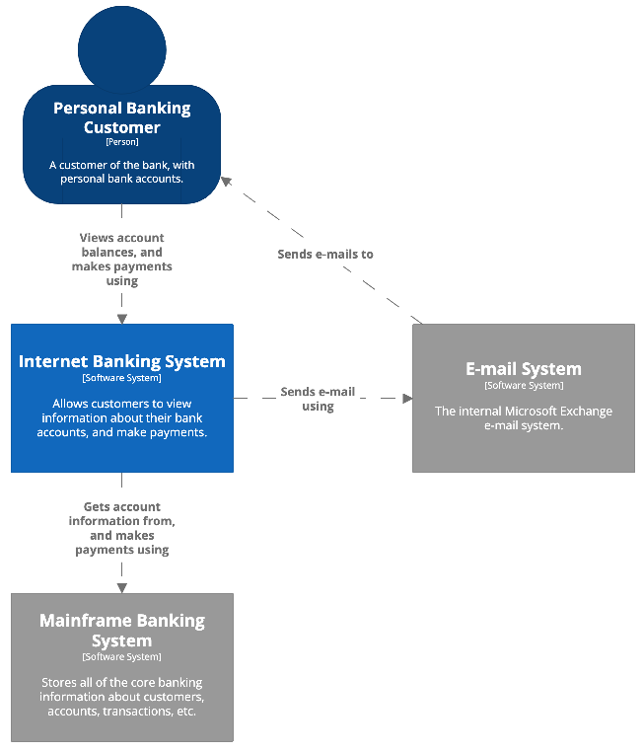
C4 and context models
C4‘s first level diagram is a system context diagram. It is showing a big picture of the system landscape. This is a diagram one could show for non-technical people.
C4

Slide 19
Interaction models

Slide 20
Interaction models
Modeling user interaction is important as it helps to identify user requirements.
Modeling system-to-system interaction highlights the communication problems that may arise.
Modeling component interaction helps us understand if a proposed system structure is likely to deliver the required system performance and dependability.
Use case diagrams and sequence diagrams may be used for interaction modelling.

Slide 21
Use case modeling
Use cases were developed originally to support requirements elicitation and now incorporated into the UML.
Each use case represents a discrete task that involves external interaction with a system.
Actors in a use case may be people or other systems.
Represented diagrammatically to provide an overview of the use case and in a more detailed textual form.

Slide 22
Example: Transfer-data use case

Slide 23
Example: Tabular description of the ‘Transfer data’ use-case
MHC-PMS: Transfer data
Actors | Medical receptionist, patient records system (PRS)
Description | A receptionist may transfer data from the Mentcase system to a general patient record database that is maintained by a health authority. The information transferred may either be updated personal information (address, phone number, etc.) or a summary of the patient’s diagnosis and treatment.
Data | Patient’s personal information, treatment summary
Stimulus | User command issued by medical receptionist
Response | Confirmation that PRS has been updated
Comments | The receptionist must have appropriate security permissions to access the patient information and the PRS.

Slide 24
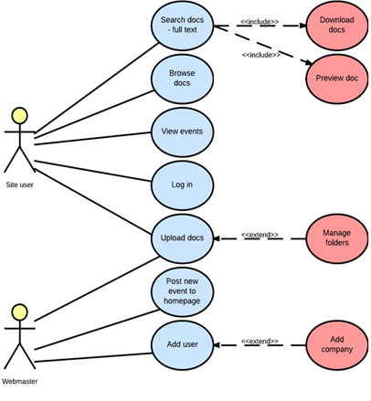
Use cases and the relationships between them
“As user I want to search docs so I can preview and download it”

Slide 25
Sequence diagrams
Sequence diagrams are part of the UML and are used to model the interactions between the actors and the objects within a system.
A sequence diagram shows the sequence of interactions that take place during a particular use case or use case instance.
The objects and actors involved are listed along the top of the diagram, with a dotted line drawn vertically from these.
Interactions between objects are indicated by annotated arrows.

Slide 26
Example: Sequence diagram for View patient information

Slide 27
Structural/Static models

Slide 28
Structural models
Structural models of software display the organization of a system in terms of the components that make up that system and their relationships.
Structural models may be static models, which show the structure of the system design, or dynamic models, which show the organization of the system when it is executing.
You create structural models of a system when you are discussing and designing the system architecture.

Slide 29
Class diagrams
Class diagrams are used when developing an object-oriented system model to show the classes in a system and the associations between these classes.
An object class can be thought of as a general definition of one kind of system object.
When you are developing models during the early stages of the software engineering process, objects represent something in the real world, such as a patient, a prescription, doctor, etc.

Slide 30
Basic components of a class
The standard class diagram is composed of three sections:
Upper section: Contains the name of the class. This section is always required, whether you are talking about the classifier or an object.
Middle section: Contains the attributes of the class. Use this section to describe the qualities of the class. This is only required when describing a specific instance of a class.
Bottom section: Includes class operations (methods). Displayed in list format, each operation takes up its own line. The operations describe how a class interacts with data.

Slide 31
Class relationships: Generalization
In modeling systems, it is often useful to examine the classes in a system to see if there is scope for generalization. If changes are proposed, then you do not have to look at all classes in the system to see if they are affected by the change.
In object-oriented languages, such as Java, generalization is implemented using the class inheritance mechanisms built into the language.
In a generalization, the attributes and operations associated with higher-level classes are also associated with the lower-level classes.
The lower-level classes are subclasses inherit the attributes and operations from their superclasses. These lower-level classes then add more specific attributes and operations.

Slide 32
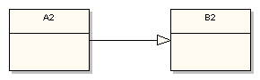
Class relationships: Generalization
import B2;
public class A2 extends B2 { // . . . }

Slide 33
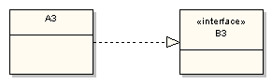
Class relationships: Realization
This relationship is somewhat related to generalization, but a bit different. In object-oriented programming parlance realization represents the implementation of an interface by a class.
import B3;
public class A3 implements B3 {
// . . .
}

Slide 34
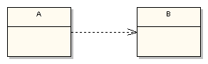
Class relationships: Dependency
The UML dependency relationship is the least formal of them all. It means that the class at the source end of the relationship has some sort of dependency on the class at the target (arrowhead) end of the relationship. For example, the following simple states that class A depends on class B in some way:
import B;
public class A {
public void method1(B b) { // . . . }
public void method2() { B tempB = new B(); }
}

Slide 35
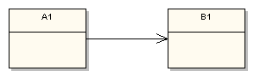
Class relationships: Association
Association defines dependency, but a much stronger dependency than that described above with the plain dependency relationship. The arrowhead means that there is a one-way relationship. In this example it means that class A1 is associated with class B1. In other words, class A1 uses and contains one instance of class B1, but B1 does not know about or contain any instances of class A1.
import B1;
public class A1 {
private B1 b1;
public B1 getB1() {
return b1;
}
}

Slide 36
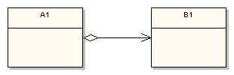
Class relationships: Aggregation
Aggregation describes an association where an instance of A1 contains a reference to an instance of B1 as part of the A1’s state, but the use of the specific instance of B1 is or may be shared among other aggregators. A shared association means that the lifetime of the aggregated object, the instance of B1 in this case, is outside the scope of the referencing object. Therefore, when a specific instance of A1 goes out of scope (e.g. garbage collected), the instance of B1 does not (of necessity) go out of scope.
import B1;
public class A1 {
private B1[] b1;
// . . .
public B1 getB1(int anIndex) {
return b1[anIndex];
}
}

Slide 37
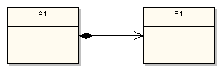
Class relationships: Composition
Composition on the other hand defines a relationship where the scope of the containing object (an A1) and the contained object (a B1) is related. When the containing object goes out of scope, then the contained object also goes out of scope. The composition adornment looks like the aggregation adornment, except the composition adornment is darkened:

Slide 38
Behavioral/Dynamic models

Slide 39
Behavioral models
Behavioral models are models of the dynamic behavior of a system as it is executing. They show what happens or what is supposed to happen when a system responds to a stimulus from its environment.
You can think of these stimuli as being of two types:
Data Some data arrives that has to be processed by the system.
Events Some event happens that triggers system processing. Events may have associated data, although this is not always the case.

Slide 40
Data-driven modeling
Many business systems are data-processing systems that are primarily driven by data. They are controlled by the data input to the system, with relatively little external event processing.
Data-driven models show the sequence of actions involved in processing input data and generating an associated output.
They are particularly useful during the analysis of requirements as they can be used to show end-to-end processing in a system.

Slide 41
An example of data-driven modelling (DFD diagram)

Slide 42
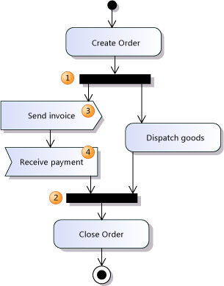
An example of object-driven modelling (Activity diagram)

Slide 43
An example of object-driven modelling (Sequence diagram)

Slide 44
State machine models
These model the behaviour of the system in response to external and internal events.
They show the system’s responses to stimuli so are often used for modelling real-time systems.
State machine models show system states as nodes and events as arcs between these nodes. When an event occurs, the system moves from one state to another.
State diagrams are an integral part of the UML and are used to represent state machine models.

Slide 45
An example of State diagram of a microwave oven

Slide 46
UML (Unified Modelling Language)

Slide 47
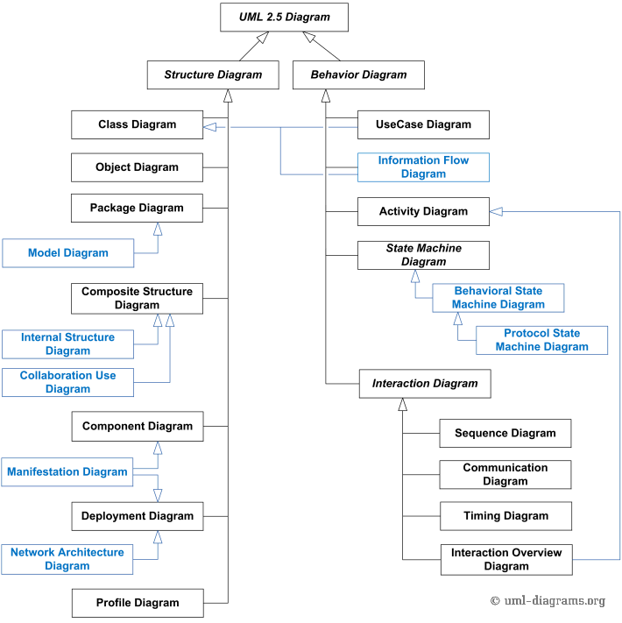
Quick view at UML diagrams
Items in blue are not part of official taxonomy of UML diagrams
Items colored with red border are not the diagrams itself – they are diagram types

Slide 48
UML advantages
De-facto modelling standard officially defined by Object Management Group (OMG). It is actually a standard unlike other modelling languages.
UML allows to communicate various software aspects, but does not dictate the software process.
There are many UML tools that can generate code from the design, apply design patterns, mine requirements, reverse engineer code, and perform impact and complexity analysis.
UML has the advantage that it is widely, although by no means universally, known throughout the software development community.
UML is graphically oriented modelling language, but it has a well-defined underlying semantic model, called the UML metamodel. It means that UML diagrams are not only the pictures.

Slide 49
UML disadvantages
UML has the disadvantage of being weak at describing functional behavior and tending to present the world in concepts from the object-oriented programming domain.
A lot of developers don’t prefer the complexity and the formality at the architectural level, which discourages the use of UML and has become one of its disadvantages.
UML is a misunderstood standard (?) Many consider UML to be more suitable for waterfall process. UML and Agile? How UML modelling embrace changes?
Not Necessary in ‘Architecture-Indifferent Design’. A term coined by George Fairbanks, ‘architecture-indifferent design’ is a situation where UML is considered unnecessary.
As a communication tool, it's slower than ad hoc diagramming. It is not a whiteboard friendly language (?). You need tools to use UML to its full extent.

Slide 50
C4 model
C4

Slide 51
C4 ideas
The idea is to provide defined model for visualising software architecture.
The model should be easy to use and understand, whiteboard friendly.
The model is based on the idea of „software maps“ (like google maps). The best tool to help navigation is a zoom-in, zoom-out functionality.
The C4 model map has 4 zoom levels
The C4 model is an "abstraction-first" approach to diagramming software architecture, based upon abstractions that reflect how software architects and developers think about and build software.
The small set of abstractions and diagram types makes the C4 model easy to learn and use.
Tool support (Structurizr, Enterprise Architect, draw.io, Visio...)
C4

Slide 52
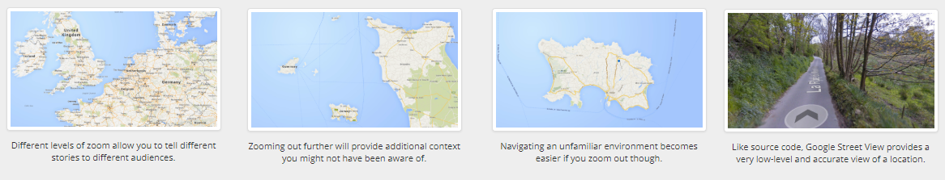
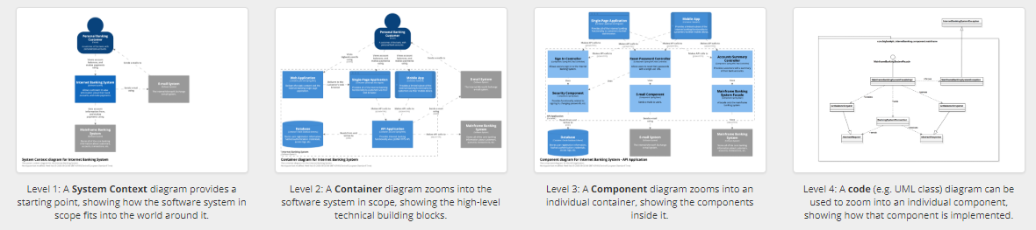
C4 software maps
C4

Slide 53
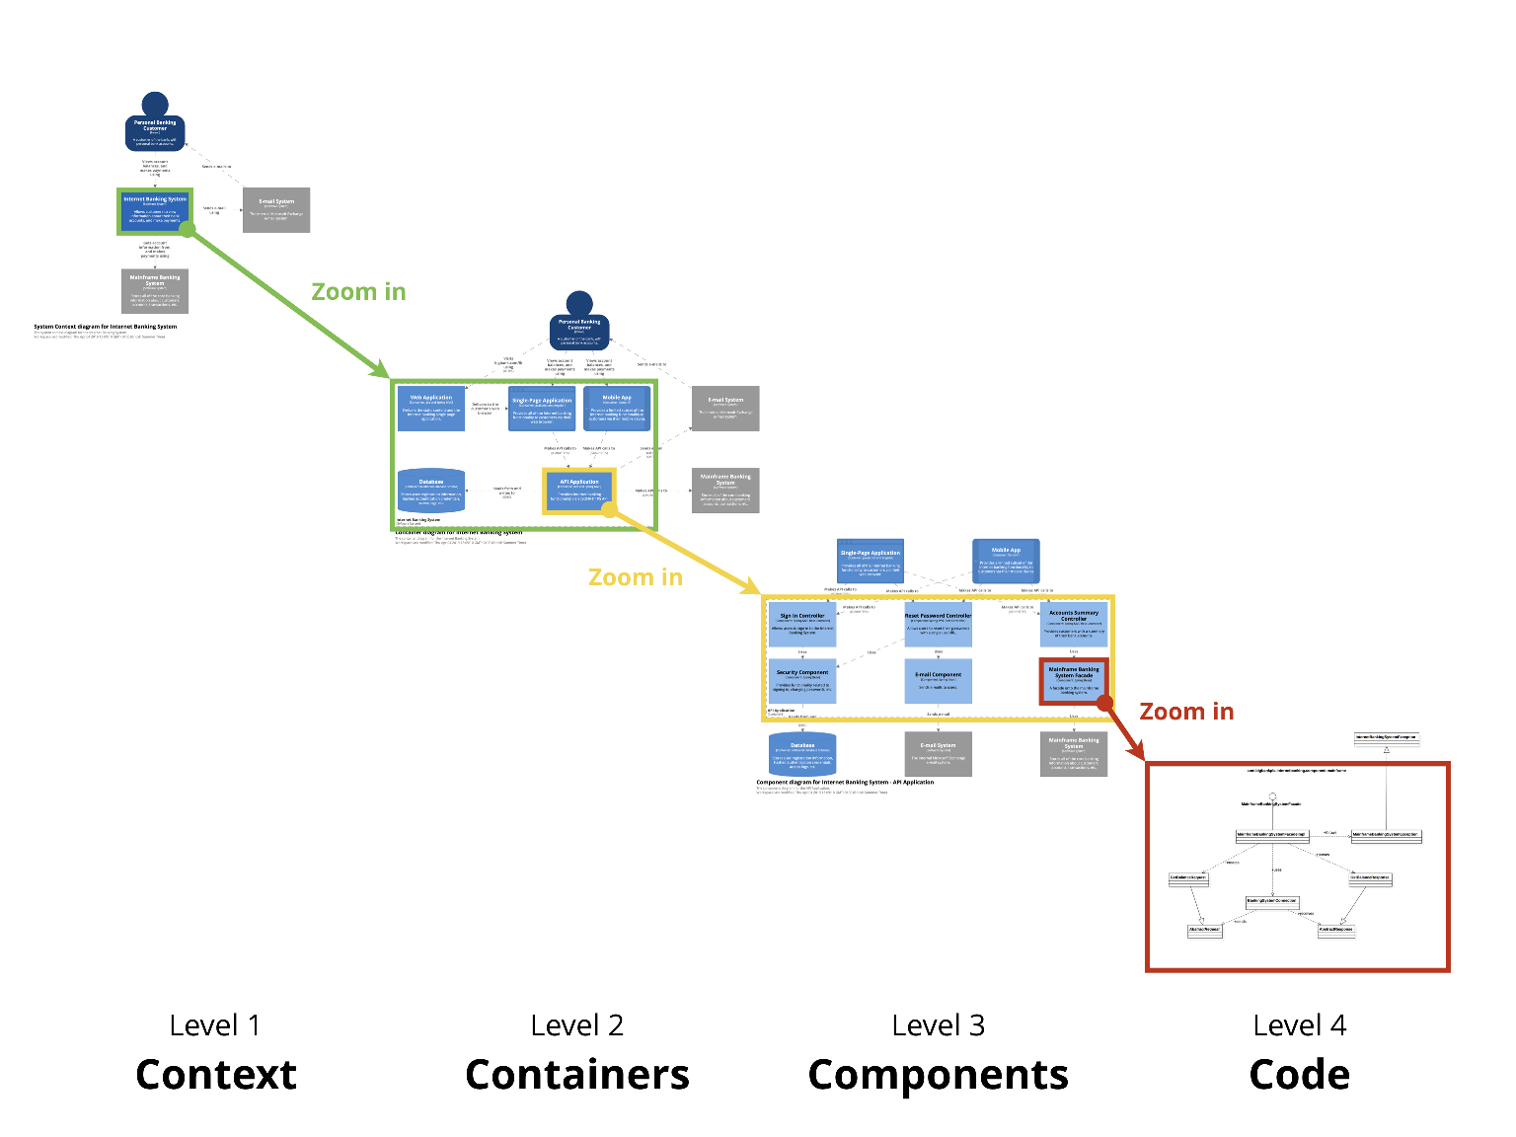
C4 software maps
C4

Slide 54
C4 abstractions
The C4 model considers the static structures of a software system in terms of containers, components and code. And people use the software systems that we build.
A person represents one of the human users of your software system (e.g. actors, roles, personas, etc).
A software system is the highest level of abstraction and describes something that delivers value to its users, whether they are human or not.
A container represents an application or a data store. A container is something that needs to be running in order for the overall software system to work: Server-side web app, Client-side web app, Mobile app, Microservice, Database, Blob or content store, File system, shell script, etc...
A component is a grouping of related functionality encapsulated behind a well-defined interface. If you're using a language like Java or C#, the simplest way to think of a component is that it's a collection of implementation classes behind an interface.
C4

Slide 55
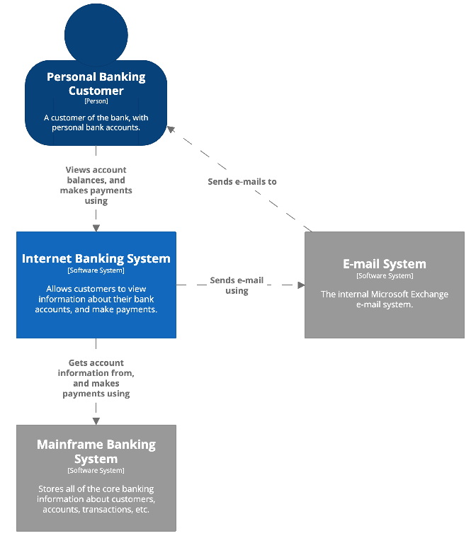
C4 diagrams: system context diagram
Scope: A single software system.
Primary elements: The software system in scope. Supporting elements: People (e.g. users, actors, roles, or personas) and software systems (external dependencies) that are directly connected to the software system in scope. Typically these other software systems sit outside the scope or boundary of your own software system, and you don’t have responsibility or ownership of them.
Intended audience: Everybody, both technical and non-technical people, inside and outside of the software development team.
C4

Slide 56
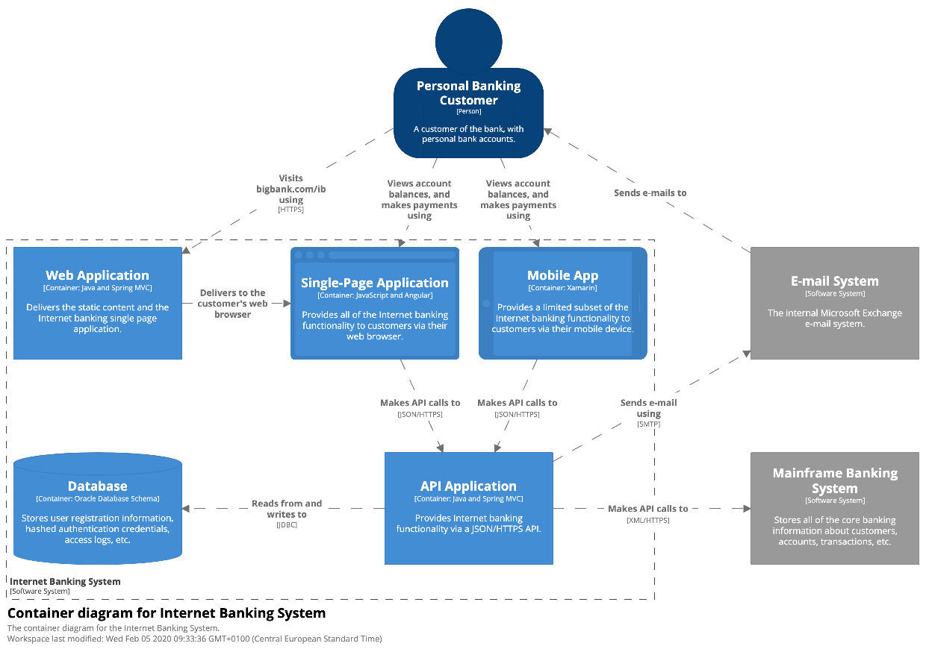
C4 diagrams: container diagram
Scope: A single software system.
Primary elements: Containers within the software system in scope. Supporting elements: People and software systems directly connected to the containers.
Intended audience: Technical people inside and outside of the software development team; including software architects, developers and operations/support staff.
Notes: This diagram says nothing about deployment scenarios, clustering, replication, failover, etc.
C4

Slide 57
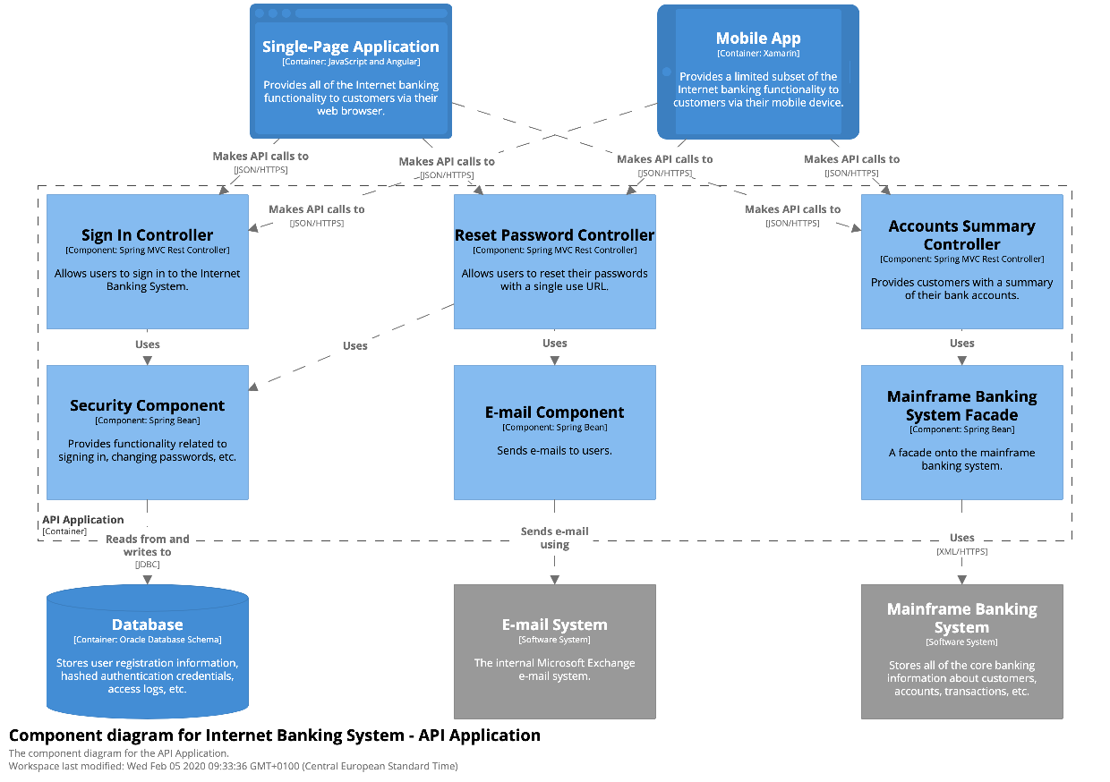
C4 diagrams: component diagram
Scope: A single container.
Primary elements: Components within the container in scope. Supporting elements: Containers (within the software system in scope) plus people and software systems directly connected to the components.
Intended audience: Software architects and developers.
C4

Slide 58
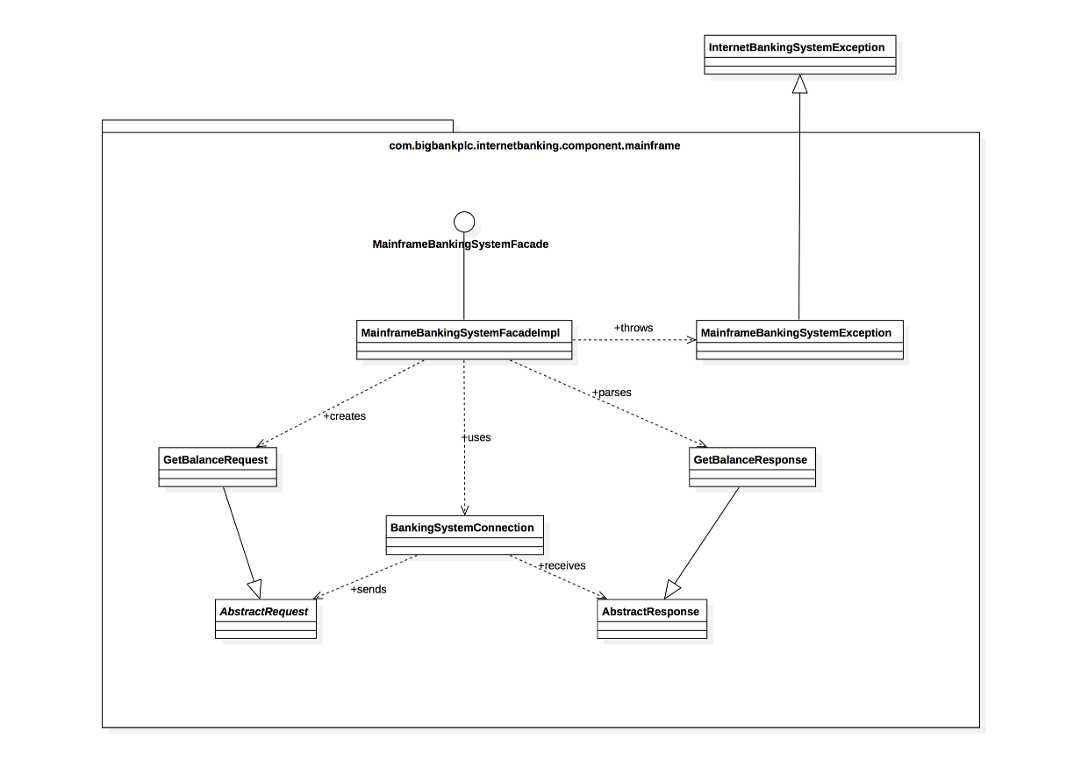
C4 diagrams: code (optional)
Scope: A single component.
Primary elements: Code elements (e.g. classes, interfaces, objects, functions, database tables, etc) within the component in scope.
Intended audience: Software architects and developers.
C4

Slide 59
C4 disadvantages
Describes mainly Design activity from Software Development Lifecycle (SDLC).
Describes mainly Structural perspective although S4 has a diagram called Dynamic diagram (based on UML communication diagram).
The model is not a standard. It is not known as widely as UML.
C4

Slide 60
Model-driven engineering

Slide 61
Model-driven engineering
Model-driven engineering (MDE) is an approach to software development where models rather than programs are the principal outputs of the development process.
The programs that execute on a hardware/software platform are then generated automatically from the models.
Proponents of MDE argue that this raises the level of abstraction in software engineering so that engineers no longer have to be concerned with programming language details or the specifics of execution platforms.

Slide 62
Usage of model-driven engineering
Model-driven engineering is still at an early stage of development, and it is unclear whether or not it will have a significant effect on software engineering practice.
Pros
Allows systems to be considered at higher levels of abstraction
Generating code automatically means that it is cheaper to adapt systems to new platforms.
Cons
Models for abstraction and not necessarily right for implementation.
Savings from generating code may be outweighed by the costs of developing translators for new platforms.

Slide 63
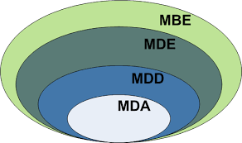
Model driven architecture
Model-driven architecture (MDA) was the precursor of more general model-driven engineering
MDA is a model-focused approach to software design and implementation that uses a subset of UML models to describe a system.
Models at different levels of abstraction are created. From a high-level, platform independent model, it is possible, in principle, to generate a working program without manual intervention.

Slide 64
Types of model
A computation independent model (CIM)
These model the important domain abstractions used in a system. CIMs are sometimes called domain models.
A platform independent model (PIM)
These model the operation of the system without reference to its implementation. The PIM is usually described using UML models that show the static system structure and how it responds to external and internal events.
Platform specific models (PSM)
These are transformations of the platform-independent model with a separate PSM for each application platform. In principle, there may be layers of PSM, with each layer adding some platform-specific detail.

Slide 65
MDA transformations

Slide 66
Multiple platform-specific models

Slide 67
How to describe the logic (algorithms)?
Executable UML (or xUML)
xUML combines a subset of the UML graphical notation with executable semantics and timing rules.
The action language defines the actions or operations that perform processing on model elements.
There are several action languages and only one is a graphical one.
Foundation UML (or fUML)
The Object Management Group has standardized the Foundational UML (fUML), which was strongly influenced by Executable UML.
Action Language for Foundational UML (ALF), is a standard action language specification by the Object Management Group.

Slide 68
Agile methods and MDA
The developers of MDA claim that it is intended to support an iterative approach to development and so can be used within agile methods.
The notion of extensive up-front modeling contradicts the fundamental ideas in the agile manifesto and I suspect that few agile developers feel comfortable with model-driven engineering.
If transformations can be completely automated and a complete program generated from a PIM, then, in principle, MDA could be used in an agile development process as no separate coding would be required.

Slide 69
Adoption of MDA
A range of factors has limited the adoption of MDE/MDA
Specialized tool support is required to convert models from one level to another
There is limited tool availability and organizations may require tool adaptation and customization to their environment
For the long-lifetime systems developed using MDA, companies are reluctant to develop their own tools or rely on small companies that may go out of business

Slide 70
Adoption of MDA
Models are a good way of facilitating discussions about a software design. However the abstractions that are useful for discussions may not be the right abstractions for implementation.
For most complex systems, implementation is not the major problem – requirements engineering, security and dependability, integration with legacy systems and testing are all more significant.
The arguments for platform-independence are only valid for large, long-lifetime systems. For software products and information systems, the savings from the use of MDA are likely to be outweighed by the costs of its introduction and tooling.
The widespread adoption of agile methods over the same period that MDA was evolving has diverted attention away from model-driven approaches.

Slide 71
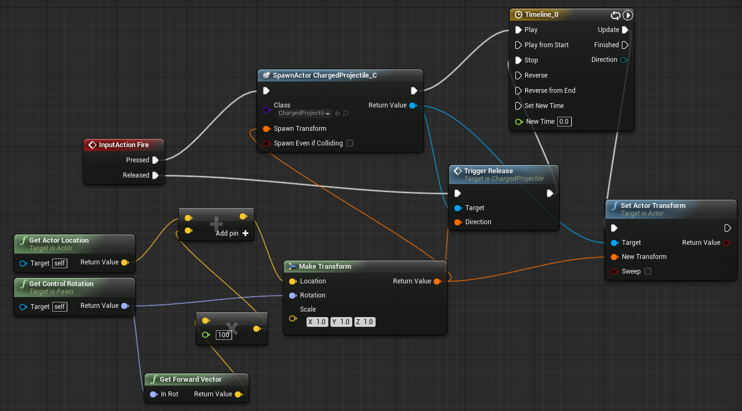
Pragmatic MDA
Developers use software generation already for ages.
So, let’s use the things which “work”.
Let’s blend MDA with traditional mechanisms such as round-trip engineering.

Slide 72
Final questions
Do I need to understand software models, UML, C4?
Should I do modelling?
When should I do modelling?
What should I model?
Source code as a model?
Modelling and Agile?

Slide 73
Key points

Slide 74
Key points
A model is an abstract view of a system that ignores system details. Complementary system models can be developed to show the system’s context, interactions, structure and behavior.
Context models show how a system that is being modeled is positioned in an environment with other systems and processes.
Structural models show the organization and architecture of a system.
Behavioral models are used to describe the dynamic behavior of an executing system.

Slide 75
Key points
UML is a well-known standard language for modelling software.
C4 model is a light way to visualize architecture for Agile teams.
Model-driven engineering is an approach to software development in which a system is represented as a set of models that can be automatically transformed to executable code.

